Slide 1


ADNI Genetics Core
Update
Andy Saykin
WW-ADNI Meeting
London, UK
July 14, 2017
asaykin@iupui.edu

Slide 2
Overview and 2017 Updates
ADNI-3 sample collection (banked at NCRAD)
Longitudinal DNA & RNA (12 new, 79 continuing)
Changes in ADNI-3 include PBMC and RBC collection
Use of genetic data from ADNI (L. Shen et al, IU)
WGS mtDNA variant calls dataset (K. Kauwe, BYU)
WGS analysis collaboration with IBM/Watson via ADSP
Cognitive subtypes as endophenotypes (P. Crane, UW)
MODEL-AD: Model systems U54 (IU/JAX/Sage)
Analyses w/ AD Metabolomics Consortium (next)
New longitudinal epigenetics data projects – telomere length and DNA methylation (w/PPSB WG)

Slide 3
Conceptual Foundation
Path from genetic signal to targeted therapeutics (applications to drug discovery and development)
Core Report
Alzheimer’s & Dementia 11 (2015) 792-814
http://www.alzheimersanddementia.com/article/S1552-5260(15)00177-6/pdf

Slide 4
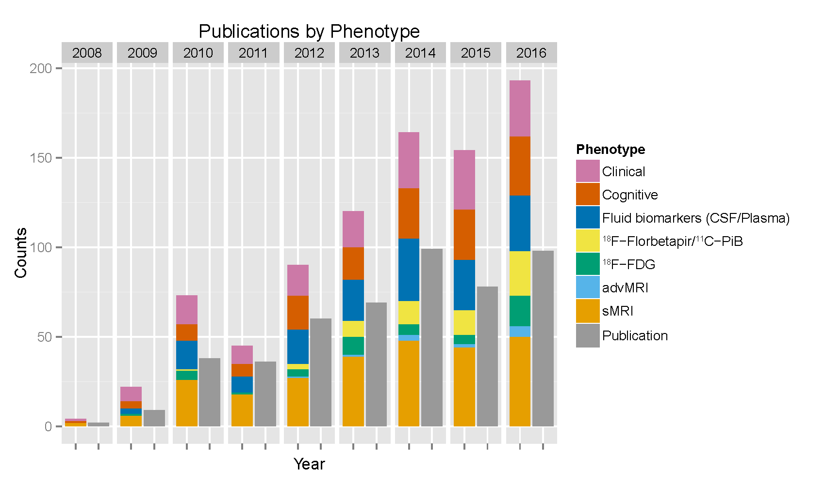
Genetics studies Using ADNI Endophenotypes:
Publications Using ADNI Genetic Data (2008–2016)
Year | Pubs
2008 | 2
2009 | 9
2010 | 38
2011 | 36
2012 | 60
2013 | 69
2014 | 99
2015 | 78
2016 | 98
Yao et al, AAIC 2017; Shen et al, Brain Imaging Behav 2014; Saykin et al, Alzheimers Dement 2015
Updated: 4/2017
Notes:
As of 11/16/2016
Gray bar indicates the total number of publications.
Note that one paper can be counted multiple times in the color bar.
Data Source: We searched the PubMed database using the EndNote X7 online search tool with the following three criteria: (1) the “All Fields” contains
“Alzheimer’s Disease Neuroimaging Initiative”; (2) the “All Fields” contains “APOE,” “apolipoprotein,” “gene,” “genetic,” “genetics,” “genome,” “genomic,” or “genomics”;
and, (3) the “Year” field value is between 2015 and 2016. We manually reviewed all the abstracts and identified 159 relevant ADNI genetic publications through this extensive search.

Slide 5
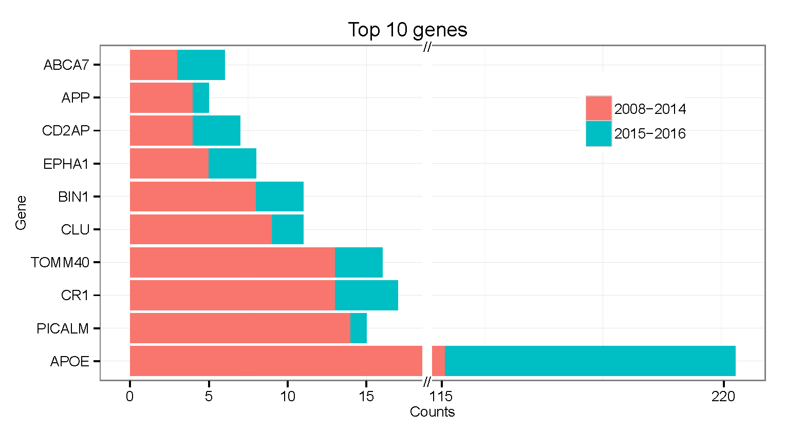
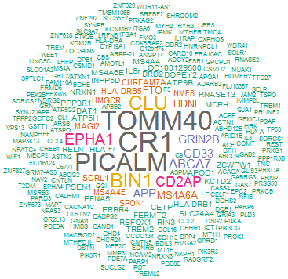
Most frequently reported genes in manuscripts using ADNI genetic data (2008–2016)
Updated: 4/2017
Yao et al, AAIC 2017; Shen et al, Brain Imaging Behav 2014; Saykin et al, Alz & Dement 2015

Slide 6
title
1. Strategies to decrease heterogeneity − Selecting patients with baseline measurements in a narrow range (decreased inter-patient variability) and excluding patients whose disease or symptoms improve spontaneously or whose measurements are highly variable (less intra-patient variability).
2. Prognostic enrichment strategies − choosing patients with a greater likelihood of having a disease-related endpoint event (for event-driven studies) or a substantial worsening in condition (for continuous measurement endpoints); increase absolute effect between groups.
3. Predictive enrichment strategies − choosing patients more likely to respond to the drug treatment than other patients with the condition being treated. Such selection can lead to a larger effect size (both absolute and relative) and permit use of a smaller study population.
FDA, 2012

Slide 7
Increasing Studies of Polygenic Risk Scores
Mormino, E.C., et al., Polygenic risk of Alzheimer disease is associated with early- and late-life processes. Neurology, 2016. 87(5): p. 481-8.
Hohman, T.J., et al., Discovery of gene-gene interactions across multiple independent data sets of late onset Alzheimer disease from the Alzheimer Disease Genetics Consortium. Neurobiol Aging, 2016. 38: p. 141-50.
Gaiteri, C., et al., Genetic variants in Alzheimer disease - molecular and brain network approaches. Nat Rev Neurol, 2016. 12(7): p. 413-27.
Yokoyama, J.S., et al., Decision tree analysis of genetic risk for clinically heterogeneous Alzheimer's disease. BMC Neurol, 2015. 15: p. 47.
Martiskainen, H., et al., Effects of Alzheimer's disease-associated risk loci on cerebrospinal fluid biomarkers and disease progression: a polygenic risk score approach. J Alzheimers Dis, 2015. 43(2): p. 565-73.
Escott-Price, V., et al., Common polygenic variation enhances risk prediction for Alzheimer's disease. Brain, 2015. 138(Pt 12): p. 3673-84.
Desikan, R.S., et al., Genetic assessment of age-associated Alzheimer disease risk: Development and validation of a polygenic hazard score. PLoS Med, 2017. 14(3): p. e1002258.

Slide 8
Polygenic Hazard Score (Desikan et al 2017)
- Based on IGAP GWAS data from 17,008 AD cases & 37,154 controls
- Assoc. with HIP & ERC MRI in ADNI
Fig 4. Annualized incidence rates showing the instantaneous hazard as a function of polygenic hazard score percentile and age.
Desikan, R.S., et al., Genetic assessment of age-associated Alzheimer disease risk: Development and validation of a polygenic hazard score. PLoS Med, 2017. 14(3): p. e1002258.

Slide 9

Cognitively-defined AD Subgroups as Phenotypes
- Differential top candidate gene loadings for AD subgroups from the ACT neuro-pathologically characterized cohort suggests biological differences

Slide 10
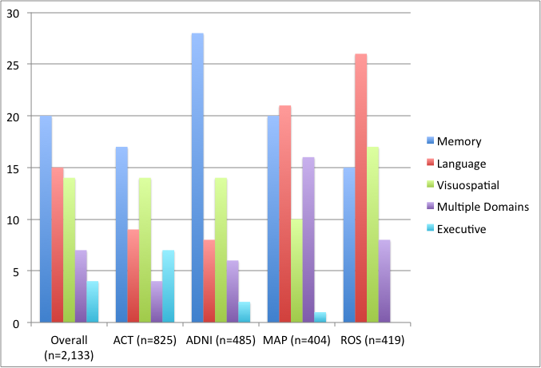
Cognitively-defined Subgroups Across Cohorts
R01 AG 042437
P. Crane et al
Memory most common overall, followed by language
Isolated substantial language deficits quite marked in MAP and especially ROS
Too few with isolated substantial executive functioning deficits for genetic analyses
Multiple domains more common in MAP and ROS than in ADNI or ACT

Slide 11
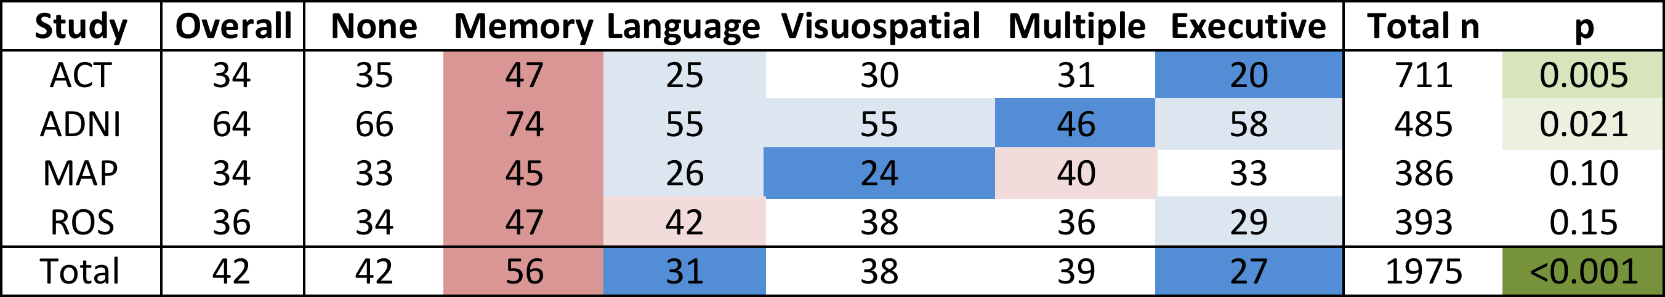
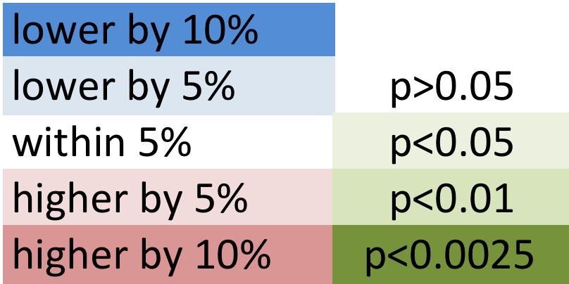
Genetics of Subtypes
APOE: Proportion with ≥1 ε4 alleles
Next Steps: Work underway to analyze IGAP SNPs enriched in each phenotypic subgroup
Paul Crane et al, EPAD consortium, unpublished data
Notes:
Corrected version

Slide 12




Model Organism Development and Evaluation for Late-onset Alzheimer’s Disease (MODEL-AD)
Contact PI: Bruce Lamb
MPIs: Carter, Howell & Territo
ADNI contributes target nominations & characterization
MODEL-AD is creating organisms based on ADNI reports
Website: https://Model-AD.org
Contact: ModelAD@iupui.edu
Data: https://www.synapse.org/#!Synapse:syn2580853/wiki/409840

Slide 13
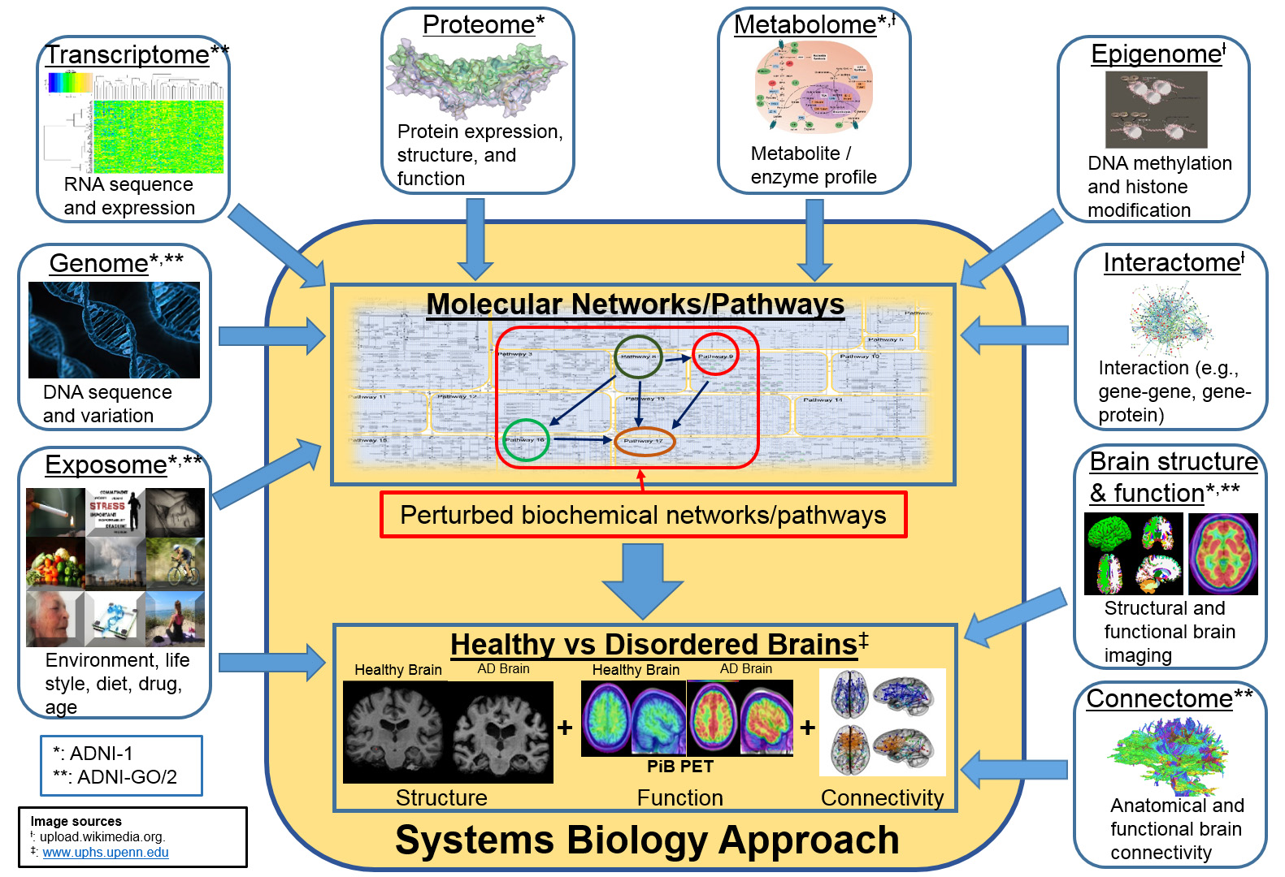

Working Toward a Systems Biology of AD
Genetics Core – Saykin et al Alzheimer’s & Dementia 11 (2015) 792-814
Notes:
Sources of Images:
Metabolome: http://upload.wikimedia.org/wikipedia/commons/c/c4/TumorMetabolome.jpg
Epigenome: http://upload.wikimedia.org/wikipedia/commons/a/a2/Epigenetics_of_adipose_development..jpg
Interactome: http://upload.wikimedia.org/wikipedia/commons/b/b4/The_protein_interaction_network_of_Treponema_pallidum.png
Healthy vs Disordered Brain: http://www.uphs.upenn.edu/news/News_Releases/2013/12/verma/verma_large.jpg

Slide 14
ADNI Epigenetics Work in Progress DNA Methylation and Telomere Length Assays Data and QC Completed April 2017
Study Design | Age (years; Mean, SD) | Male (N, %) | APOE ε4 positive (N,%)
Cross-sectional (All Individuals)*
Cognitively Nornal (n=221) | 76.27 (6.63) | 111 (50%) | 57 (26%)
Mild Cognitive Impairment (n=335) | 72.58 (7.82) | 188 (56%) | 153 (46%)
Alzheimer's Disease (n=93) | 77.19 (7.69) | 60 (65%) | 63 (68%)
Longitudinal design*
Cognitively Nornal (n=195) | 75.96 (6.54) | 97 (50%) | 50 (26%)
Mild Cognitive Impairment (n=283) | 72.23 (7.73) | 157 (55%) | 117 (41%)
Alzheimer's Disease (n=93) | 77.19 (7.69) | 60 (65%) | 63 (68%)
Pre-/post-conversion
MCI to AD (n=110) | 74.5 (7.89) | 62 (56%) | 71 (65%)
NL to AD (n=10) | 78.8 (4.05) | 7 (70%) | 4 (40%)
NL to MCI (n=42) | 78.71 (6.9) | 21 (50%) | 13 (31%)
* 80 cross-sectional samples were included
Selection criteria: WGS & GWAS, RNA profiling, > 2 year clinical follow-up, MRI and PET imaging data; converters, longitudinal DNA availability (except 80 cross sectional)
Notes:
Updated April 2016

Slide 15
Longitudinal DNA Methylation Project
AD is heritable but DNA sequence only explains a portion of the risk. Extreme example: MZ twins discordant for AD.
Epigenetics addresses gene x environment interaction.
DNA methylation is a key epigenetic mechanism influencing gene expression with CpG islands as enriched sites.
In AD, increasing attention in brain tissue with some limited observations in blood.
Longitudinal ADNI blood samples are ideal to investigate dynamic changes related to biomarkers.
C. Bock (Max Planck Institute for Informatics)
Project is a collaboration of the core and PPSB members: AbbVie, J&J and Biogen supported the Illumina Epic arrays, reagents. Assays were run at AbbVie which also provided and bioinformatics support. Data are posted on LONI.

Slide 16
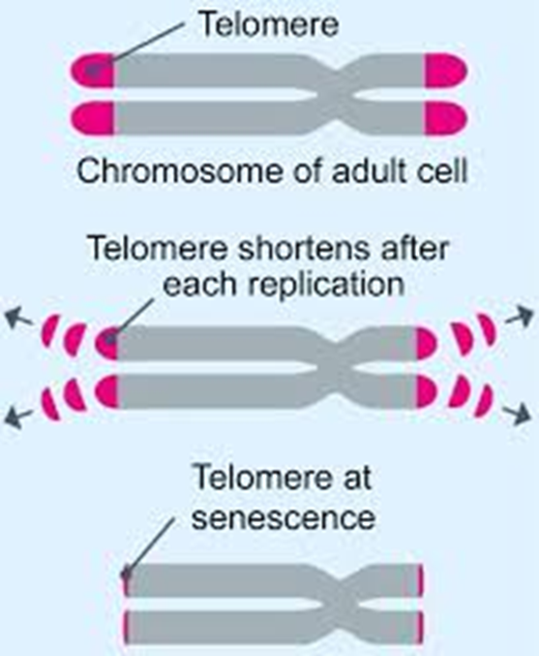
Telomere Length Project
Telomere shortening has been shown to strongly correlate with increasing age in humans (Ren et al 2009).
Related to cellular senescence, oxidative stress, mitochondrial dysfunction, inflammatory processes and DNA replication failure.
Marker of biological aging associated with pollution, smoking, stress, obesity, diet, asthma, diabetes, cardiovascular events, dementia and mortality.

Slide 17
Telomere Study Visit Data
1719 unique IDs and 199 technical replicates passed QC and were included in the unblinded data
(July 2017 Update: Analysis indicated that initial core lab assays had an instrument issue and assays are being selectively repeated; an adjusted new data set will posted on LONI asap)
V1 N=653
V2 N=569
V3 N=450
V4 N=38
V5 N=9

Slide 18
Plans and Key Future Directions
Work with interested parties to secure resources for WGS, transcriptome and epigenetic profiling of ADNI’s longitudinal DNA and RNA samples (e.g., Watson/ADSP)
Continue AD systems biology research with ADMC, AMP-AD/MOVE-AD, and other partners
Facilitate replication studies with other cohorts
Collaborate with academic and industry partners on molecular and functional validation follow-up studies including the IU/JAX/Sage MODEL-AD U54
Collaborate with the Neuropathology Core to relate differential pathological features to genetic variation

Slide 19

Genetics Core/Working Groups
Indiana University
Imaging Genomics Lab
Andrew Saykin (Leader)
Li Shen (co-Leader)
Liana Apostolova
Sungeun Kim
Kwangsik Nho
Shannon Risacher
Kelly Nudelman
National Cell Repository for AD
Tatiana Foroud (co-Leader)
Kelley Faber
PPSB Working Groups
Aparna Vasanthakumar (AbbVie)*
PPSB Chairs
FNIH Team
* Genetics Core Liaison & Epigenetics WG
Core Collaborators/Consultants
Steven Potkin (UCI; co-Leader)
Robert Green (BWH)
Paul Thompson (USC)
Rima Kaddurah-Daouk (Duke)**
** AD Metabolomics Consortium
Other Collaborators – RNA and other NGS Projects:
Keoni Kauwe (BYU) mtDNA
Yunlong Liu (Indiana) – mRNA
Epigenetics Working Group (PPSB):
Wade Davis (AbbVie)
Jeffrey Waring (AbbVie)
Qingqin Li (J&J)
Karol Estrada (Biogen)
Systems Biology Working Group
2017

